Slide 1


LOAN PREDICTION SYSTEM
Presented by :-
Animesh Kumar Roy
ADTU/0/2024-26/MCAM/033
MCA in AI & DL

Slide 2
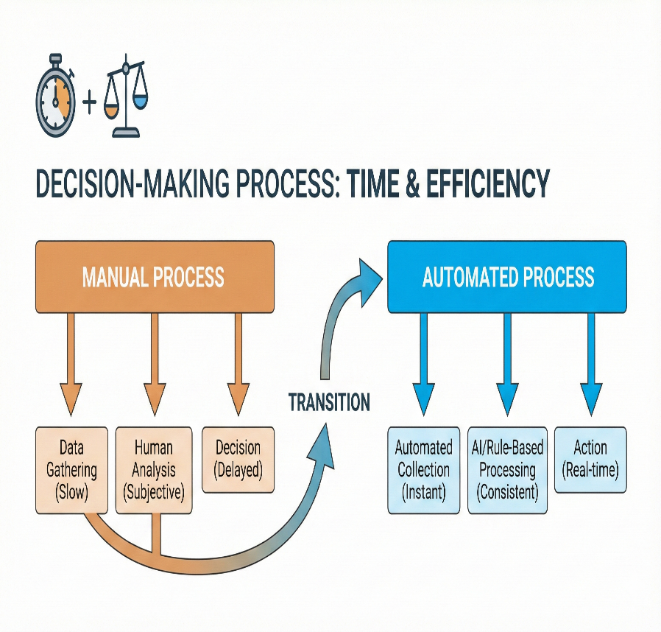
Problem Statement-
Loan approval is critical for banks & applicants
Manual evaluation is slow and inconsistent
Need for automated, data-driven prediction system

Slide 3
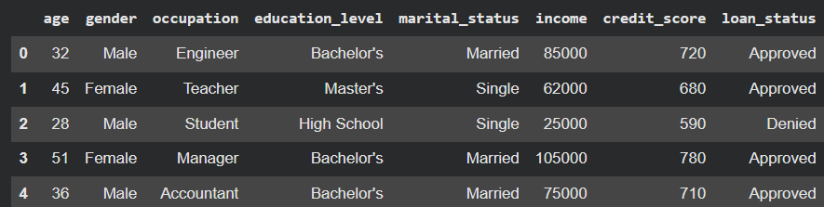
Dataset Overview
Dataset Details (loan.csv):
• Features include:
◦ age, gender, occupation
◦ education_level, marital_status
◦ income, credit_score
• Target: loan_status (Approved / Denied)
• Dataset contains both numerical & categorical data

Slide 4
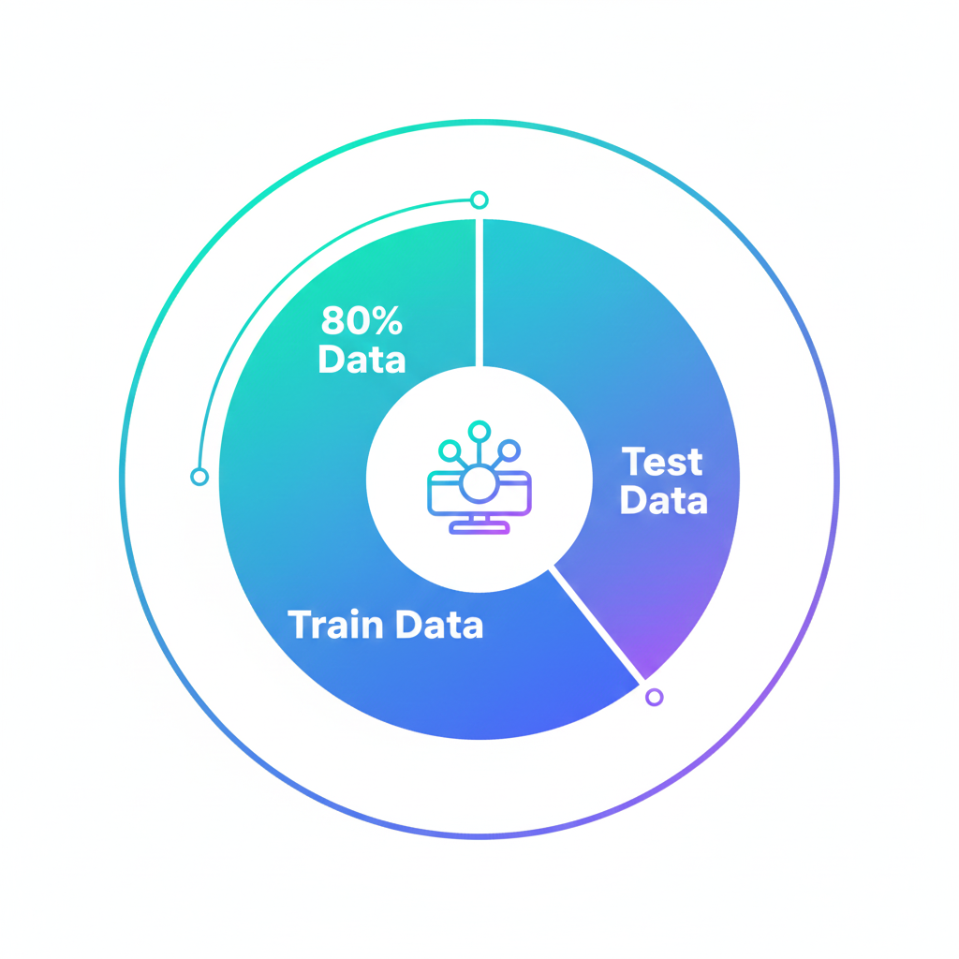
Data Preprocessing
Encoding:
• Label Encoding applied to:
◦ gender
◦ occupation
◦ education_level
◦ marital_status
◦ loan_status
• Train-Test Split:
◦ 80% Training
◦ 20% Testing

Slide 5
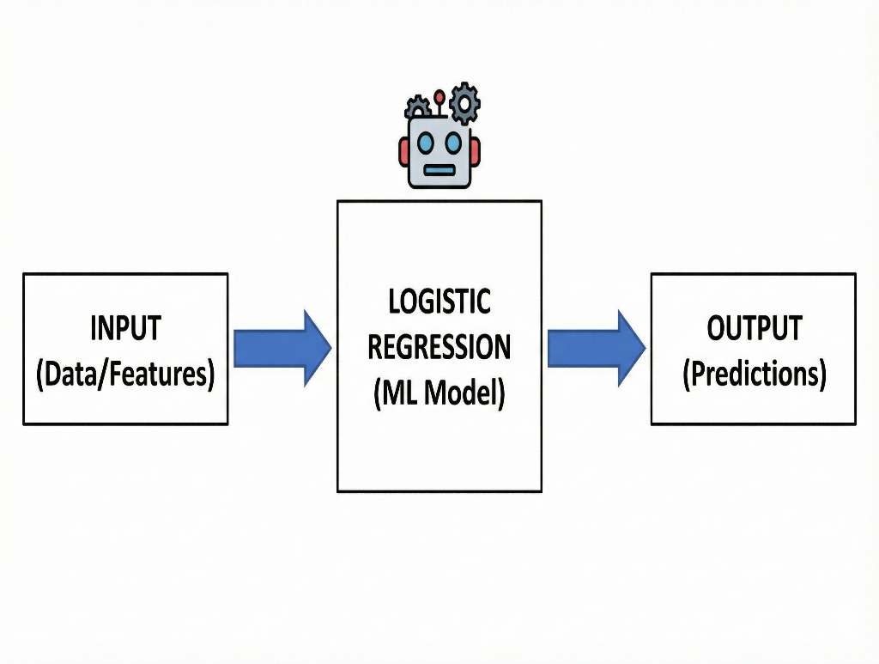
Model Building
Logistic Regression Model:
• Algorithm used: Logistic Regression
• Trained to predict loan approval
•Model accuracy displayed in UI

Slide 6
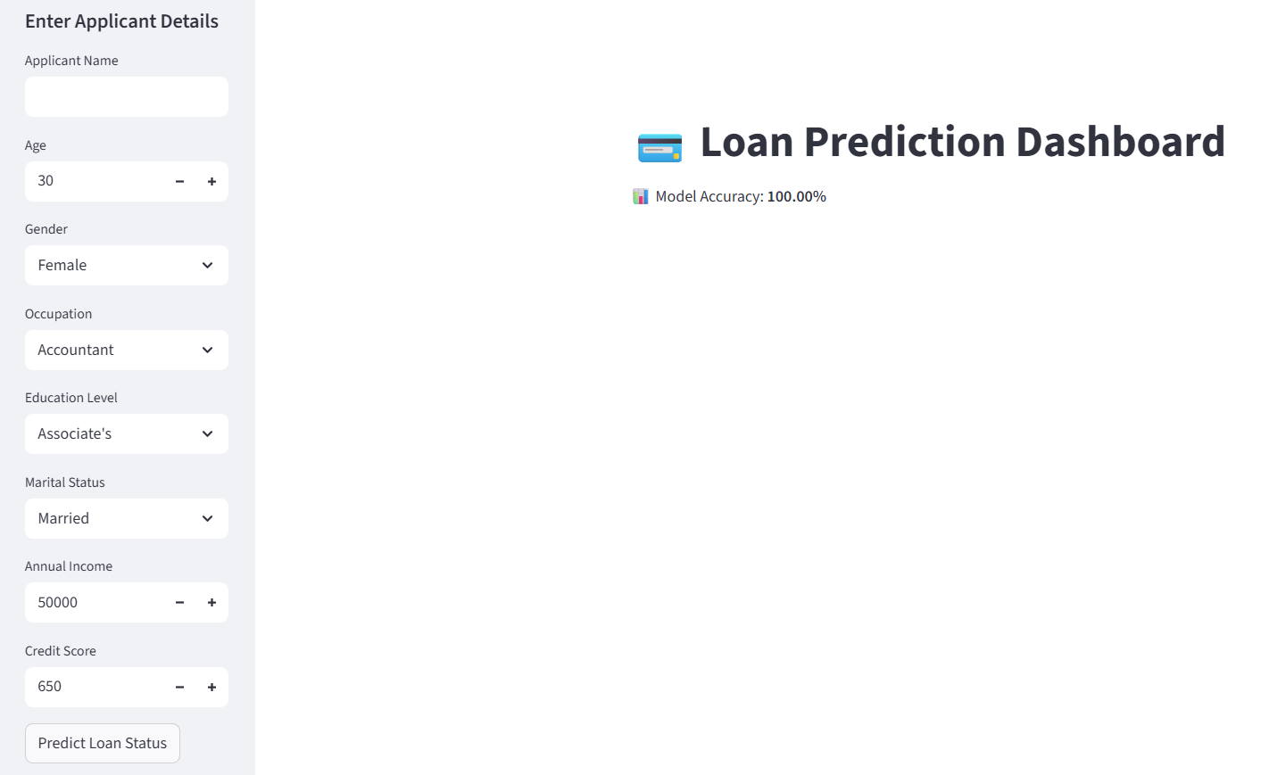
Streamlit App Interface
Sidebar input: (Applicant name)
•Age, Gender, Occupation
• Education, Marital Status
• Income, Credit Score
Predicts loan status instantly
Streamlit generates real-time predictions

Slide 7
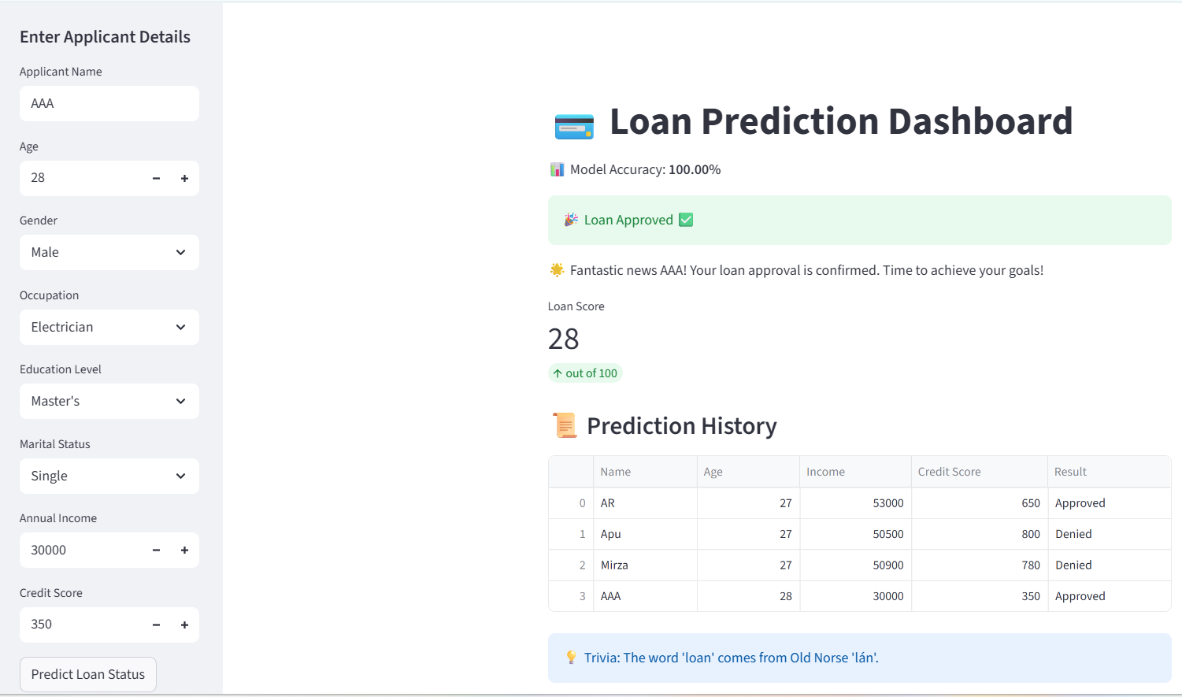
Prediction Output
Model predicts:
✔ Loan Approved
❌ Loan Denied
Loan score metric
Prediction history
Fun facts for engagement
Useful for financial decision support

Slide 8
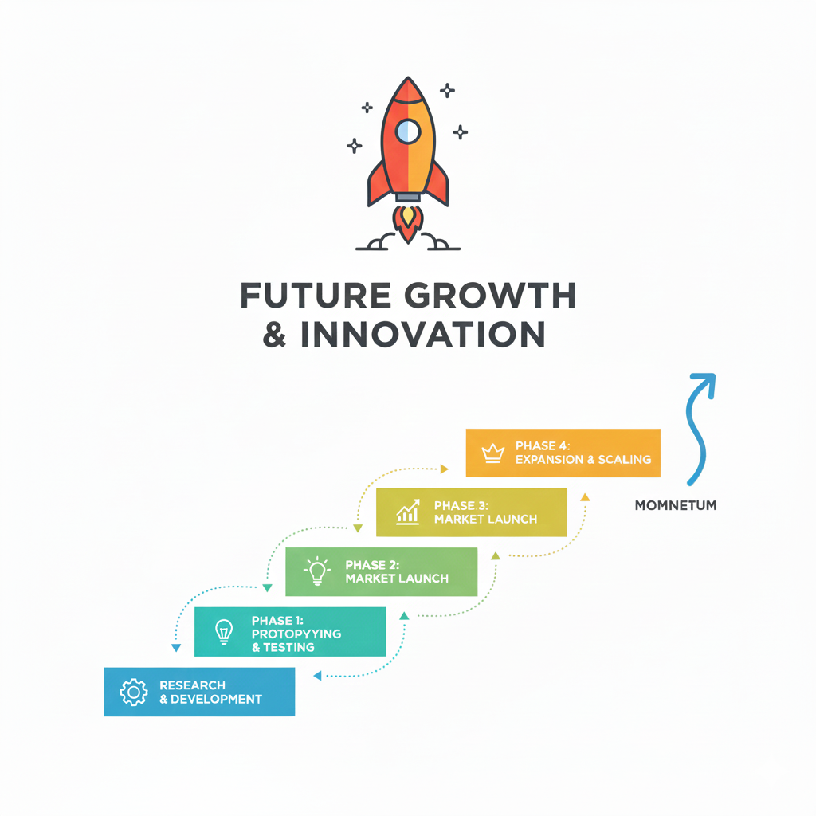
Conclusion & Future Work
Conclusion
Future work
Add more features (employment history, assets)
Try advanced models (Random Forest, Neural Networks)
Deploy with larger datasets for better accuracy
Automated loan prediction improves efficiency & consistency
User-friendly interface for applicants

Slide 9


